Slide 1

FUN & WEATHER
How Weather Impacts Attractions
January 2020

Slide 2

TEAM FRAP
Fatima Mehdikarimi, Raj Kartha, Alejandra Gomez, Priya Kulkarni

Slide 3


Slide 4
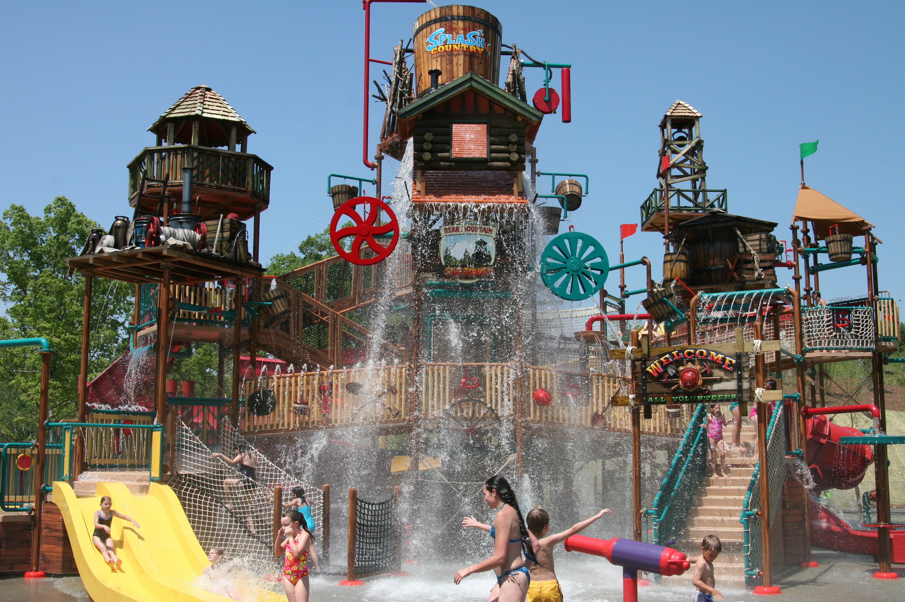
HYPOTHESIS
Weather impacts attendance at attractions: theme parks, water parks & aquariums
Reviewing five years of attendance data from Herschend Family Entertainment’s properties, we compared attendance on each day to the weather data for that day. We utilized:
Attendance data in a CSV
Historical weather data from Local Weather API

Slide 5

QUESTIONS
How does rain or snow impact:
Attendance at theme parks?
Attendance at water parks?
Attendance at aquariums?

Slide 6
PROCESS
How we cleaned, explored and prepared our data
Attendance CSV File
Weather API
After receiving a file with dozens of columns, analyzed which columns were needed
Brought file into Jupyter Notebook and discussed how to format and organize data
Ultimately decided on including only property name, operating date, daily attendance, date
Creating dataframes, we ran into some errors and with the help of TA, learned about strip function. Our data had extra spaces we couldn’t see and strip helped eliminate those for our formulas to actually work.
Final dataframes included annual summary of attendance grouped by property
Initially planned to use OpenWeather API we had worked on in class. However free version didn’t include historical data.
Found another weather API, WorldWeather Online, that had a free trial to their premium version. Now we had to learn their documentation and their date format didn’t match out CSV date format and required us to reformat date in dateframe.
Pulled weather data for each property location based on zip code

Slide 7
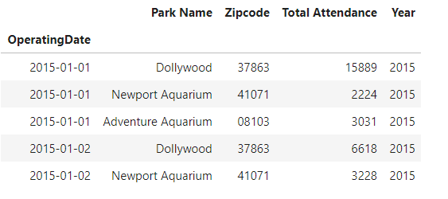
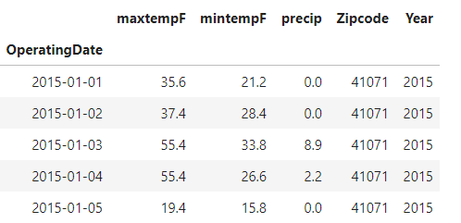
PRELIMINARY DATAFRAMES
Attendance Dataframe
Weather Dataframe

Slide 8
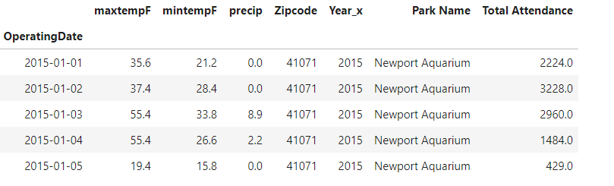
MERGED DATAFRAME

Slide 9
ANALYSIS
How we analyzed our data and prepared charts
Analysis
Matplotlib
As we were ready to merge, we added a zip code column to Attendance dataframe to enable merging with Weather API data
Merged the attendance and weather dataframes based on date
Decided to focus on precipitation, comparing the % of days impacted by precipitation versus total annual attendance
Calculated % of days impacted via True or False statement
Created chart showing annual attendance plotted by year shown against % of operating days with precipitation impact
Plotted with different scales sharing the same X axis to be able to display in millions of attendance and the % of precipitation

Slide 10

FINDINGS

Slide 11
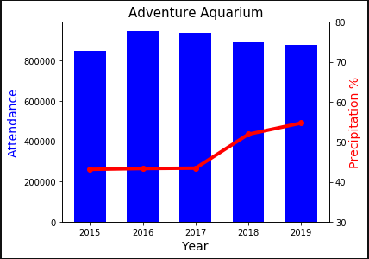
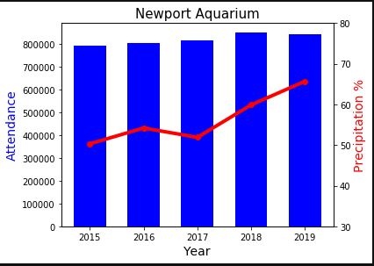
AQUARIUMS

Slide 12
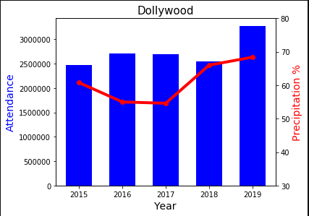
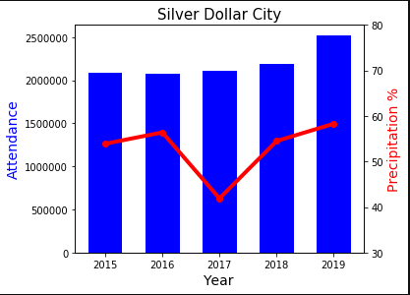
THEME PARKS

Slide 13
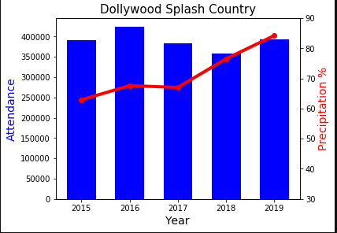
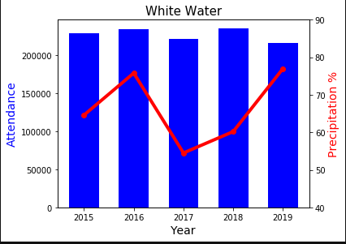
WATER PARKS

Slide 14

POST MORTEM
Based on annual data, it is hard to conclude if precipitation impacts attendance
If we had more time, we would have liked to:
We should have charted the data based on months in stead of years.
Comparing annual data hid really rainy months
Delineate the days of week by weekday and weekend
Analyze weather impact based on day of week
Compare weekday vs. weekend impact
Delved into seasonal changes

Slide 15

THANK YOU!
Questions?

